Slide 1
.Net
WEB ENGINEERING

Slide 2
Week 1 - Day 2 & 3

Slide 3

Learning Objectives
By the end of this session, the students will have reinforced to further developed an understanding of:
What is JavaScript
Inline, Internal and External JavaScript
Display Output using JavaScript
JavaScript Syntax
Statements, Variables

Slide 4
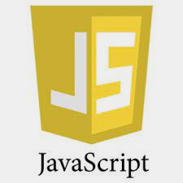
: A Quick Review
This week is focused on everyone (students with technical/non technical background) starting from the same ground with HTML & JavaScript revisions.

Slide 5
What is Javascript?
Invented by Brendan Eich (1995)
Former CTO / CEO of mozilla
A scripting language used for client-side web development
Cross-platform
Object based
Dynamic
Scripting language
Currently ECMA-262 (ECMAScript 5)
Web APIs (DOM, ..)
JScript is the Microsoft version of JavaScript.
Notes:
https://www.slideshare.net/OrdinaORAJ/javascript-basics-and-best-practices-cc-fe-ux

Slide 6
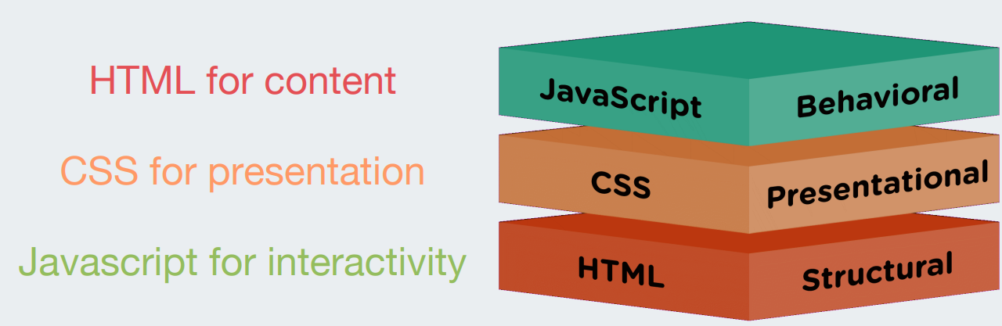
What is Javascript?

Slide 7
Language features - The good
Everything is an Object
Including functions
Objects are loosely typed
Every object can be assigned any value
Objects are dynamic
Can change type @ runtime
Add members on the fly
Object literals

Slide 8
Language features - The bad
Easy to introduce globals = root of all evil
Automatic line termination
Semicolons automatically inserted by interpreter
Can lead to quirky behavior
No warning
Object equality and Object comparison
Error prone due to dynamically typed objects
Type coercion happens automagically (= auto casting)

Slide 9
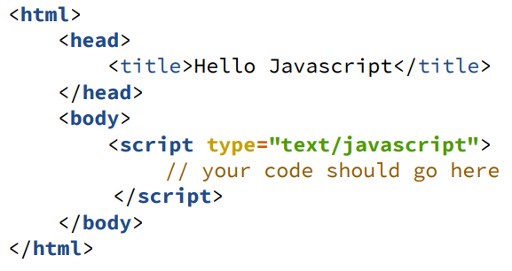
What is Javascript?
Embedding javascript in a web page
Notes:
file:///C:/Users/Admin/Desktop/Pasha%20samples/.Net/prez-171106201220-JSintro.pdf

Slide 10
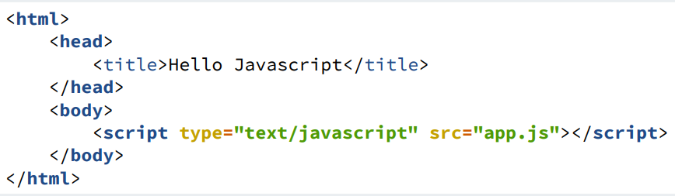
What is Javascript?
Linking to a Javascript file
Notes:
file:///C:/Users/Admin/Desktop/Pasha%20samples/.Net/prez-171106201220-JSintro.pdf

Slide 11
So, what can you do with JavaScript?
Mobile Apps
Front-end Web Development
Back-end Web Development
JavaScript as a Serverless Computing Programming Langauge
Desktop Applications
2D & 3D Game Development
Artificial Intelligence
You can write plugins for popular applications
Data Visualization
Embedded Device Development and IoT
Notes:
For details: https://www.orientsoftware.com/blog/what-can-you-do-with-javascript/
https://www.grandcircus.co/blog/10-things-you-can-build-with-javascript/
https://www.hackreactor.com/blog/what-is-javascript-used-for

Slide 12
What can JavaScript do?
Click on each option below to view the embedded example:
Javascript can change HTML content
Javascript can change HTML attributes
Javascript can hide HTML elements
Javascript can shor hidden HTML elements
Notes:
For further details: https://www.w3schools.com/js/js_examples.asp

Slide 13
Types of Javascript
We can write the javascript code in three various ways, they are
Inline javascript
Internal Javascript
External Javascript

Slide 14

Inline Javascript
Inline javascript is written within the html tags.
Try this code

Slide 15
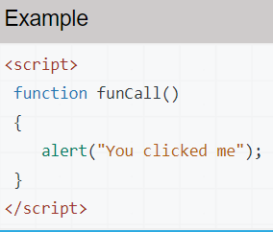
Internal Javascript
Internal javascript is written inside the <script> and </script> tags.
Try this code:

Slide 16

External Javascript
External javascript is written in a separate file and saved with .js extension.
External javascript file can be imported inside the html file using src attribute in <script> tag.
In the below example, a separate javascript file(ext.js) is created. In it we have defined funCall function. To view the javascript file Click //tutorialcodeplay.com/ext.js
Try this code:
We recommend you to define the javascript code above the </body> tag.

Slide 17
JavaScript Output
JavaScript Display Possibilities
(Click on the red links to view relevant examples)
JavaScript can "display" data in different ways:
Writing into
an HTML element, using innerHTML
the HTML output using document.write() &
Using document.write() after an HTML document is loaded, will delete all existing HTML: Example 2
The document.write() method should only be used for testing.
Notes:
https://www.w3schools.com/js/js_output.asp

Slide 18
JavaScript Output
JavaScript Display Possibilities
JavaScript can "display" data in different ways:
Writing into
an alert box, using window.alert()
You can skip the window keyword.
In JavaScript, the window object is the global scope object, that means that variables, properties, and methods by default belong to the window object. This also means that specifying the window keyword is optional: Example 2
Notes:
https://www.w3schools.com/js/js_output.asp

Slide 19
JavaScript Output
JavaScript can "display" data in different ways:
Writing into
the browser console, using console.log()
JavaScript Print: JavaScript does not have any print object or print methods.
You cannot access output devices from JavaScript.
The only exception is that you can call the window.print() method in the browser to print the content of the current window.
Notes:
https://www.w3schools.com/js/js_output.asp

Slide 20
JavaScript Syntax
JavaScript syntax refers to the set of rules that determines how JavaScript programs are constructed. The JavaScript syntax is similar to C# and Java:
Operators (+,*, =, !=, &&, ++, …)
Variables (typeless)
Conditional statements (if, else)
Loops (for, while)
Arrays (my_array[]) and associative arrays (my_array['abc'])
Functions (can return value)
Function variables (like the C# delegates)
Notes:
https://www.slideshare.net/shreesenthil/javascript-basics-231170103

Slide 21
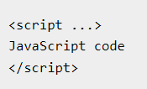
JavaScript Syntax
JavaScript syntax refers to the set of rules that determines how JavaScript programs are constructed. The JavaScript syntax is similar to C# and Java:
JavaScript can be implemented using JavaScript statements that are placed within the <script>... </script> HTML tags in a web page.
You can place the <script> tags, containing your JavaScript, anywhere within your web page, but it is normally recommended that you should keep it within the <head> tags.
The <script> tag alerts the browser program to start interpreting all the text between these tags as a script. A simple syntax of your JavaScript will appear as follows.
Notes:
https://www.slideshare.net/shreesenthil/javascript-basics-231170103

Slide 22
JavaScript Syntax
The script tag takes two important attributes −
Language − This attribute specifies what scripting language you are using. Typically, its value will be javascript. Although recent versions of HTML (and XHTML, its successor) have phased out the use of this attribute.
Type − This attribute is what is now recommended to indicate the scripting language in use and its value should be set to "text/javascript".
Notes:
https://www.tutorialspoint.com/javascript/javascript_syntax.htm

Slide 23
JavaScript Syntax
Statements
Numbers
Strings
Variables
Operators
Assignments
Expressions (Using Constants, Strings and Variables
Keywords
Comments
is case sensitive
Notes:
https://www.w3schools.com/js/js_syntax.asp

Slide 24
JavaScript Values
The JavaScript syntax defines two types of values:
Fixed values
Variable values
Fixed values are called Literals.
Variable values are called Variables.

Slide 25
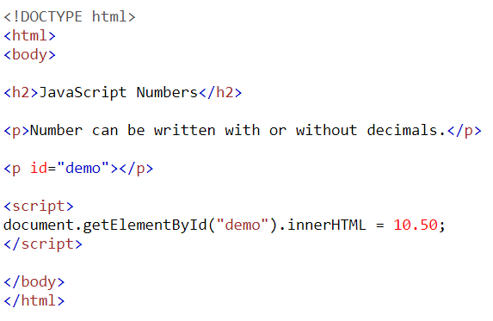
JavaScript Literals
The two most important syntax rules for fixed values are:
1. Numbers are written with or without decimals:
Try it yourself:

Slide 26
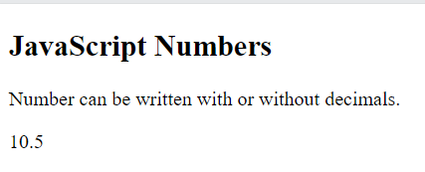
Numbers - Output

Slide 27
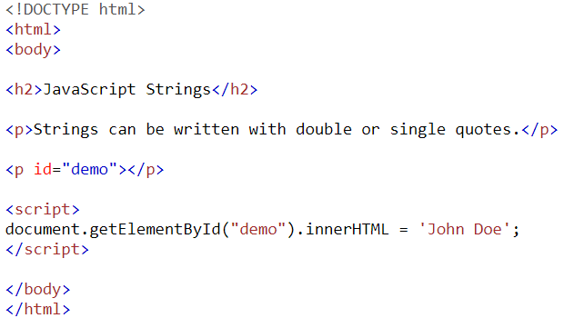
JavaScript Literals
The two most important syntax rules for fixed values are:
2. Strings are text, written within double or single quotes:
Practice Example: Try it yourself:

Slide 28
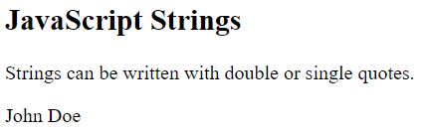
Strings - Output

Slide 29
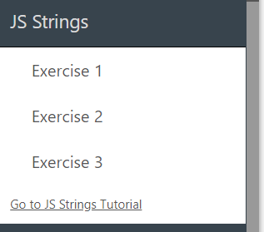
Strings - Exercises
Students will individually complete Strings exercises from this link: https://www.w3schools.com/js/exercise_js.asp?filename=exercise_js_variables3

Slide 30
Quick Recap of Day 2
What are the following:
Javascript
Language features: The Good and The Bad
Types of JavaScript
JavaScript Input
JavaScript Syntax
Literals
Numbers
Strings

Slide 31
Day 3

Slide 32
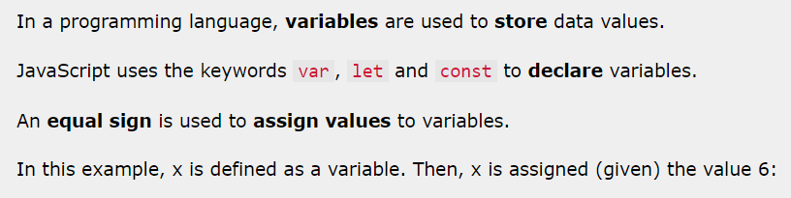
Variables

Slide 33
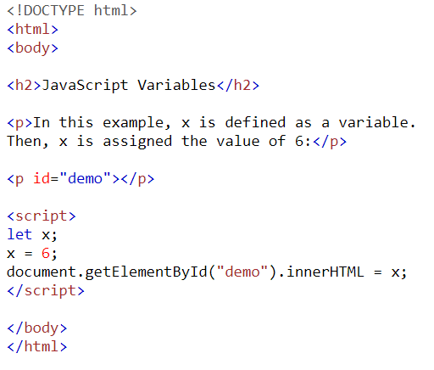
Variables - Practice Example
Try it yourself.
Then tally your answer with the one given on the next slide

Slide 34
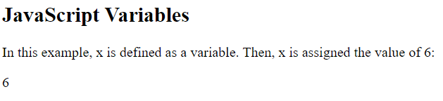
Variables - Practice Example output

Slide 35
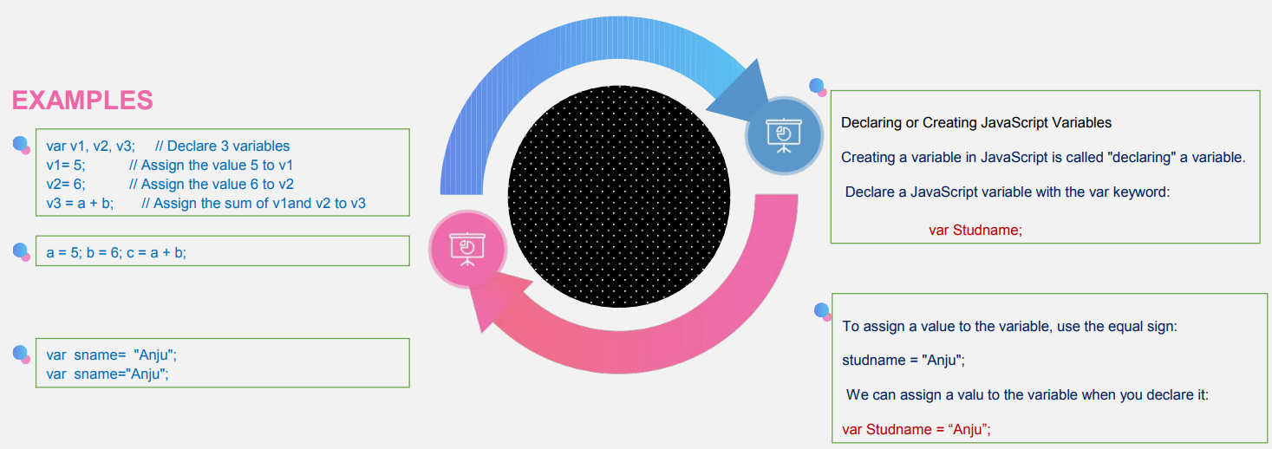
Variables

Slide 36
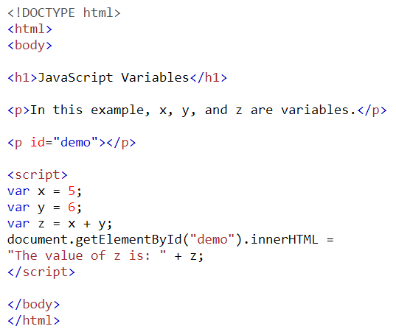
Javascript Variables
4 Ways to Declare a JavaScript Variable:
Using var
Using let
Using const
Using nothing
Variables are containers for storing data (storing data values).
In this example, x, y, and z, are variables, declared with the var keyword:
Notes:
https://www.w3schools.com/js/js_variables.asp

Slide 37
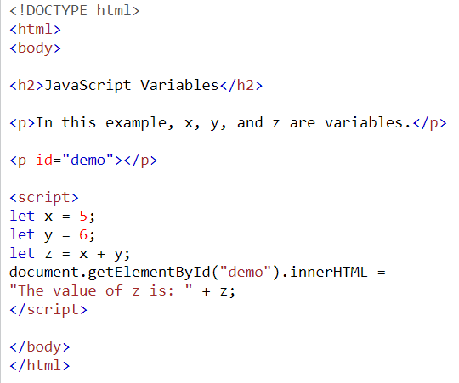
Javascript Variables
Example 2:
In this example, x, y, and z, are variables, declared with the let keyword:
Notes:
https://www.w3schools.com/js/js_variables.asp

Slide 38
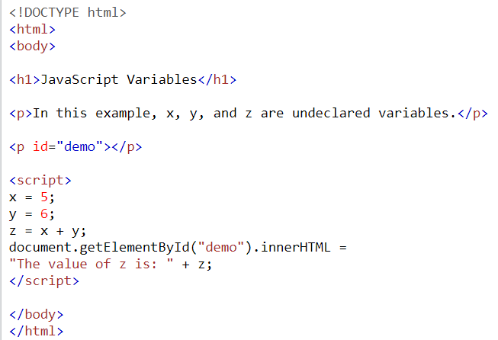
Javascript Variables
Example 3:
In this example, x, y, and z, are undeclared variables:
—-----------------------------------
From all the examples above, you can guess:
x stores the value 5
y stores the value 6
z stores the value 11
Notes:
https://www.w3schools.com/js/js_variables.asp

Slide 39
When to Use JavaScript var?
Always declare JavaScript variables with var,let, orconst.
The var keyword is used in all JavaScript code from 1995 to 2015.
The let and const keywords were added to JavaScript in 2015.
If you want your code to run in older browser, you must use var.
Notes:
https://www.w3schools.com/js/js_variables.asp

Slide 40
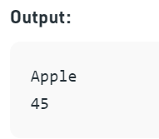
Practice Task:
Write down a JS syntax for the following output:
Check the code given on the next slide after you have completed your code.

Slide 41
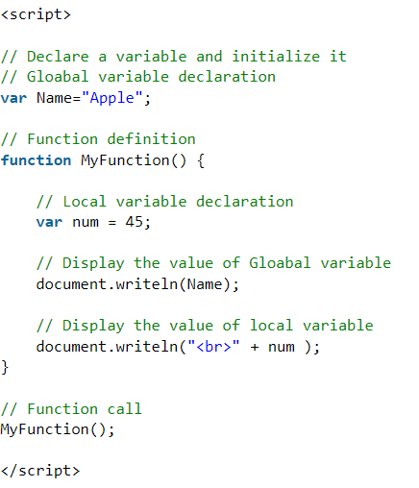
Task:
Variables
Notes:
https://www.geeksforgeeks.org/javascript-basic-syntax/?ref=lbp

Slide 42
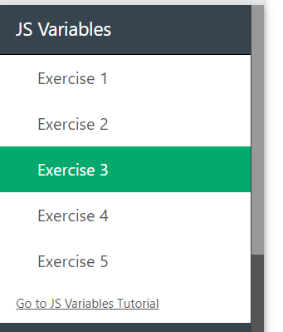
Variable Exercises:
Students will individually complete Variables exercises from this link: https://www.w3schools.com/js/exercise_js.asp?filename=exercise_js_variables3

Slide 43
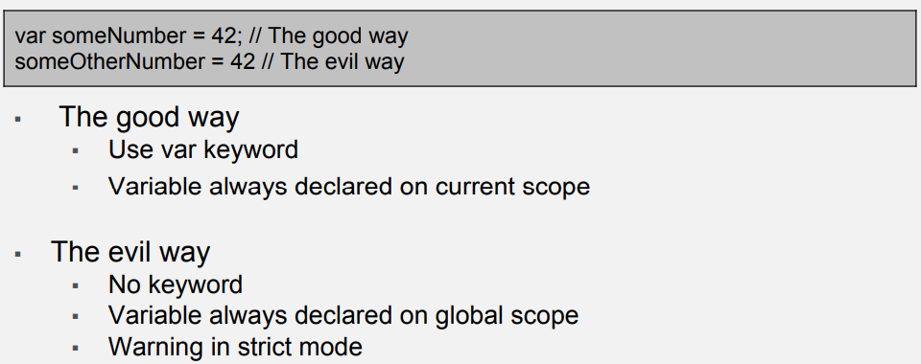
Declaring a Variable

Slide 44
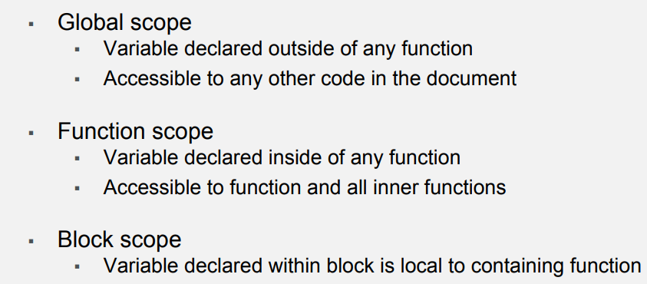
Variable Scope

Slide 45
Statements
JavaScript statements are composed of:
Values
Operators
Expressions
Keywords, and
Comments
Order of execution of Statements is the same as they are written.
Semicolons:
Semicolons separate JavaScript statements.
Semicolon marks the end of a statement in javascript
Notes:
https://www.geeksforgeeks.org/javascript-basic-syntax/?ref=lbp

Slide 46
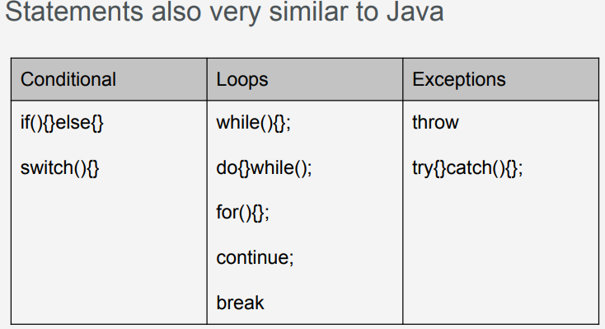
Statements

Slide 47
JavaScript - if...else Statement
Trainer will demonstrate the code writing as example. Students will follow the trainer by writing the same code or any other exmaple given in the following link:
https://www.tutorialspoint.com/javascript/javascript_ifelse.htm
JavaScript - Switch Case will also be practiced in the same way

Slide 48
JavaScript - if...else Statement
Trainer will demonstrate the code writing as example. Students will follow the trainer by writing the same code or any other example given in the following link:
https://www.tutorialspoint.com/javascript/javascript_ifelse.htm
JavaScript - Switch Case will also be practiced in the same way

Slide 49
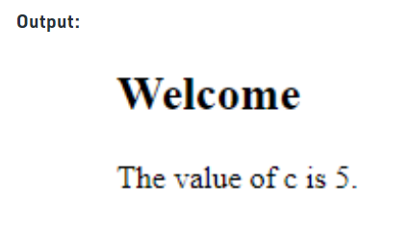
Statements:
Practice Exercise
Write a statement for the following output. Then telly your code with the one given on the next slide:

Slide 50
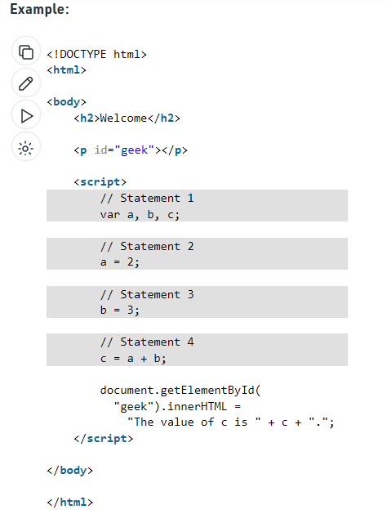
Example
Statements
Notes:
https://www.geeksforgeeks.org/javascript-statements/?ref=lbp

Slide 51
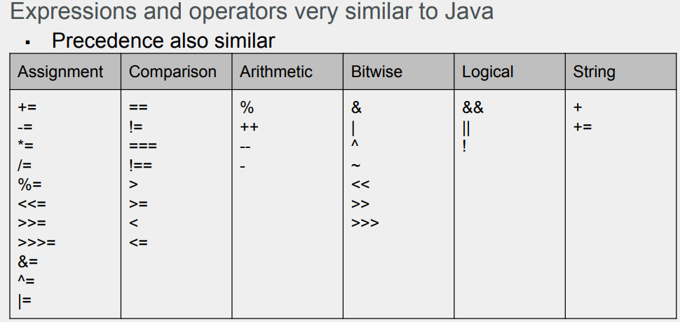
Expressions & Operators

Slide 52
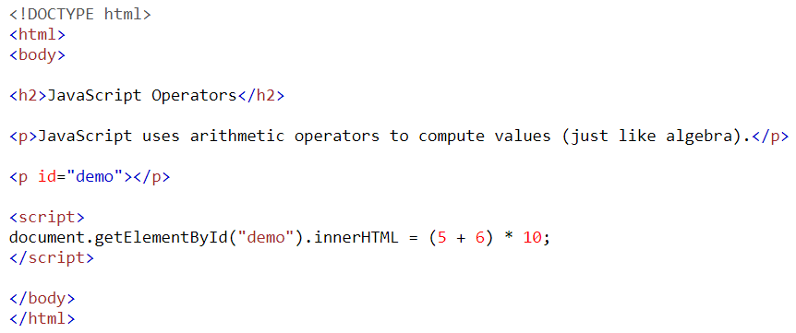
JavaScript Operators
JavaScript uses arithmetic operators ( + - * / ) to compute values:
Try it yourself.
Then tally your answer with the one given on the next slide

Slide 53
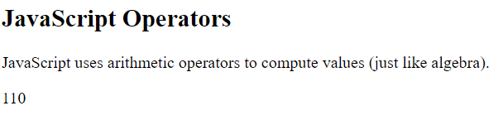
JavaScript Operators
Example Output

Slide 54
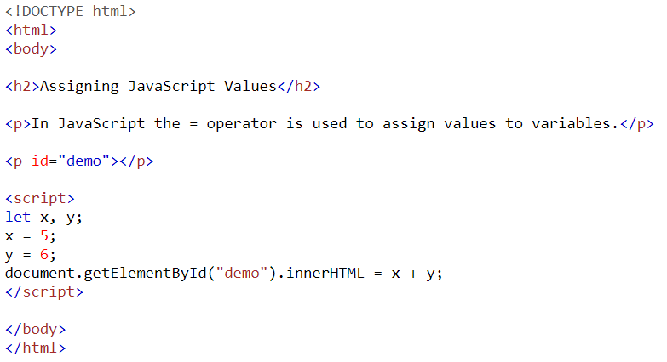
JavaScript Operators
JavaScript uses an assignment operator ( = ) to assign values to variables:
Try it yourself.
Then tally your answer with the one given on the next slide

Slide 55
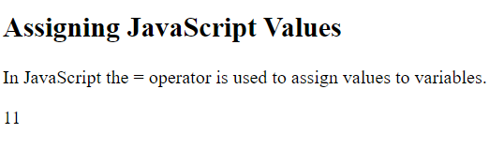
JavaScript Operators
Example Output

Slide 56
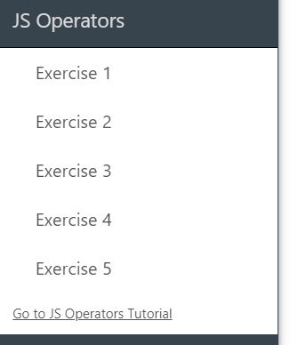
Operator Exercises:
Students will individually complete Operators exercises from this link: https://www.w3schools.com/js/exercise_js.asp?filename=exercise_js_variables3

Slide 57
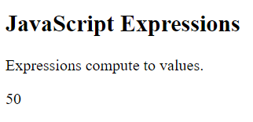
JavaScript Expressions
An expression is a combination of values, variables, and operators, which computes to a value.
The computation is called an evaluation.
For example, 5 * 10 evaluates to 50:
Try writing an expressions with the output. Tally your code with the one given on the next slide:

Slide 58
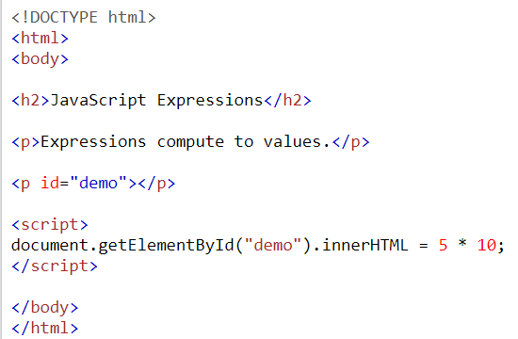
JavaScript Expressions

Slide 59
JavaScript Expressions
Practice each of the following examples in these steps:
Step 1:
Write the code on your computers
Step 2:
Tally your answer
Javascript expressions (using constants)
Javascript expressions (using strings): The values can be of various types, such as numbers and strings.
Javascript expressions (using variables): Expressions can also contain variable values.

Slide 60
JavaScript Keywords
Practice each of the following examples in these steps:
Step 1:
Write the code on your computers
Step 2:
Tally your answer
JavaScript keywords are used to identify actions to be performed.
The let keyword tells the browser to create variables:
Keywords Example

Slide 61
Functions in JavaScript
Practice each of the following examples in these steps:
Step 1:
Write the code on your computers
Step 2:
Tally your answer
JavaScript keywords are used to identify actions to be performed.
The let keyword tells the browser to create variables:
Keywords Example

Slide 62
Javascript Functions
Follow the trainer on your computers as they demonstrate the following functions on their computer.
Javascript | Arrow functions
JavaScript | escape()
JavaScript | unescape()
JavaScript | Window print()
Javascript | Window Blur() and Window Focus() Method
JavaScript | console.log()
JavaScript | parseFloat()
JavaScript | uneval()
JavaScript | parseInt()
JavaScript | match()
JavaScript | Date.parse()
JavaScipt | Replace() Method
JavaScript | Map.get( )
JavaScript | Map.entries( )
JavaScript | Map.clear( )
JavaScript | Map.delete()
JavaScript | Map.has( )

Slide 63
Variables
Javascript variables
Javascript variables as algebra
Javascript numbers and strings
Javascript var keyword
Declaring many variables in one statement
Declaring many variables multiline
A variabel without a value returns the value undefined
Re-declaring a variable will not destroy the value
Adding Javascript numbers
Adding Javascript strings
Adding strings and numbers
Homework
Practice all the examples and come prepared with your queries tomorrow.

Slide 64
Javascript
Statements
Javascript statements are commands to the browser
Javascript code is a sequence of statements
Javascript statements are separated with semicolon
Multiple statements on one line is allowed
Javascript statements can be grouped together in code blocks
You can break a code line after an operator or a comma
Homework
Practice all the examples and come prepared with your queries tomorrow.
Notes:
https://www.geeksforgeeks.org/javascript-statements/?ref=lbp

Slide 65

Learning Objectives
By the end of this session, the students have practised
What is JavaScript
Inline, Internal and External JavaScript
Display Output using JavaScript
JavaScript Syntax
Statements, Variables

Slide 66
Conclusion & Q/A
See you tomorrow!

